Slide 1

IoT Based Parking Space Occupancy Analyzer
Gr 11
Rahul Shaw (13000319007)
Sourav Bandyopadhyay (13000319012)
Amit Kumar (13000319016)
Abhishek Kumar Singh (13000319025)
Electronics and Communication Engineering
Techno Main Salt Lake

Slide 2


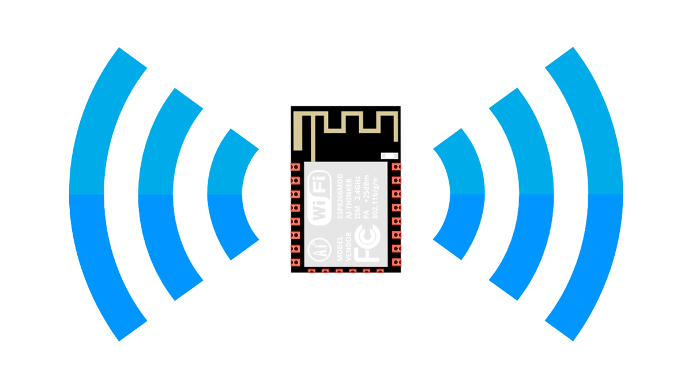


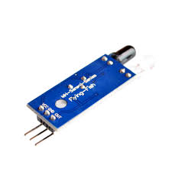


Contents
Introduction
Overview
Problem Statement and Solutions
Component list
NodeMCU and IR Sensors
Circuit Diagram & Working
Limitations
Future Aspects and Use Cases
References

Slide 3

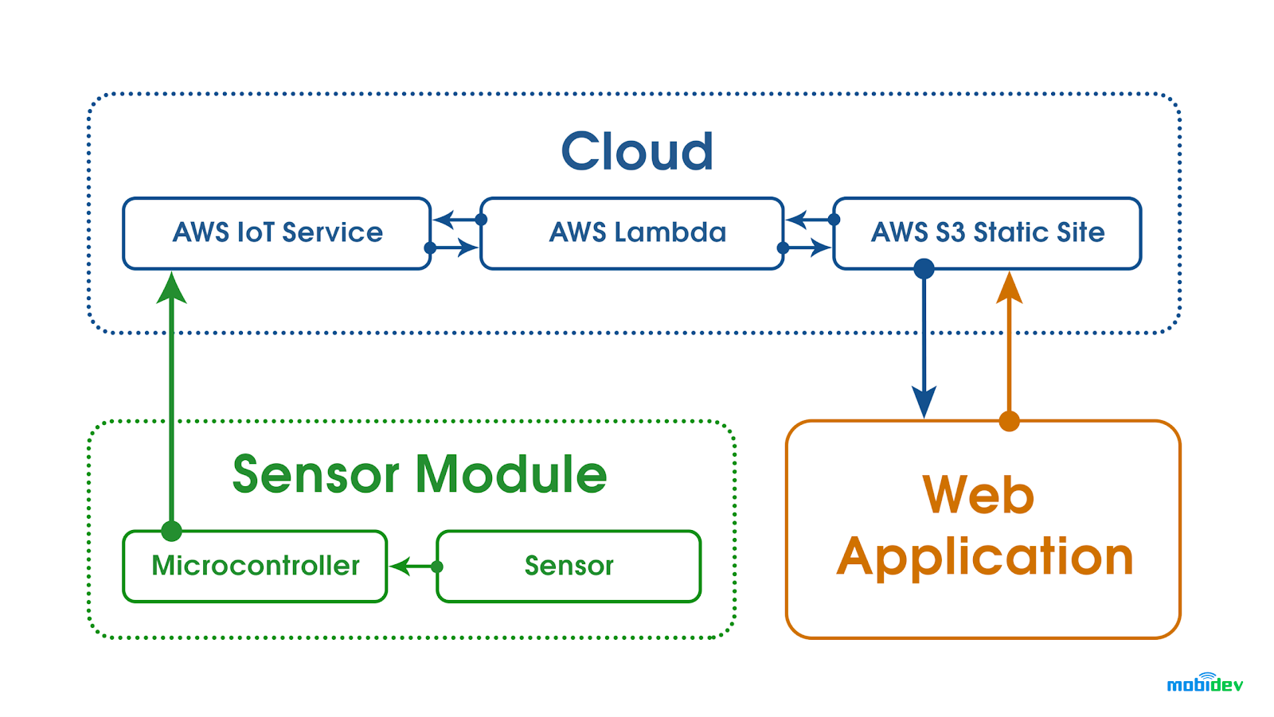

Introduction
According to the definition of IOT, it's miles the manner to interconnection with the help of the net gadgets that can be embedded to put in force the capability in normal objects by permitting them to send and acquire data.
Connectivity
Intelligence and identity
Scalability
Protection

Slide 4
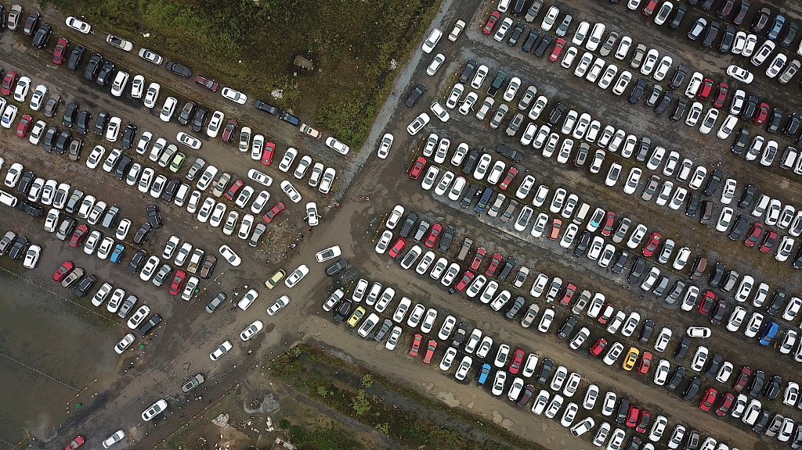
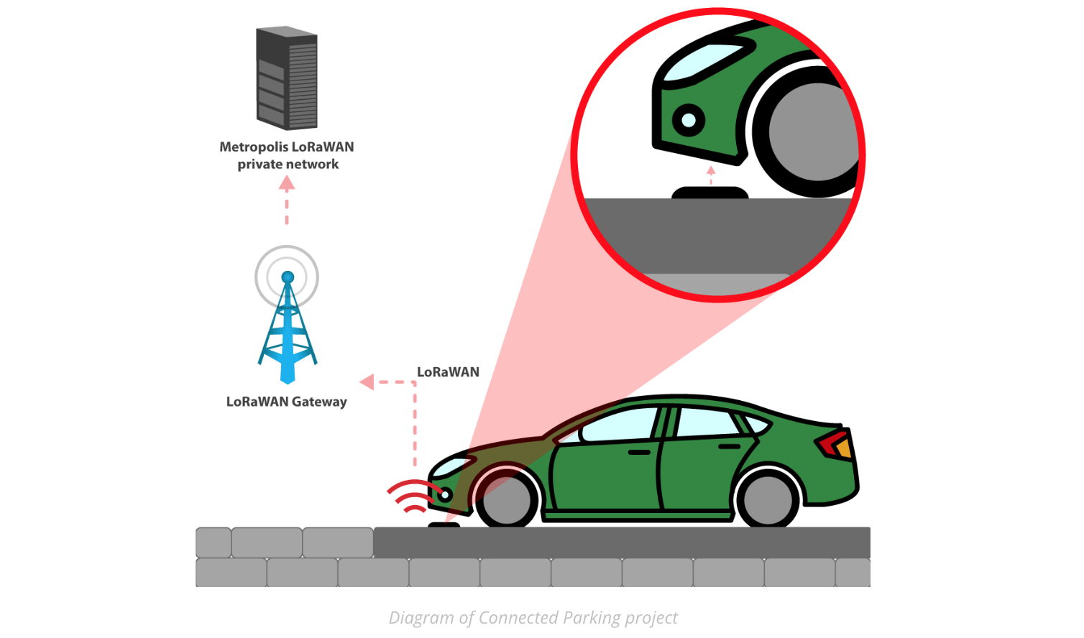
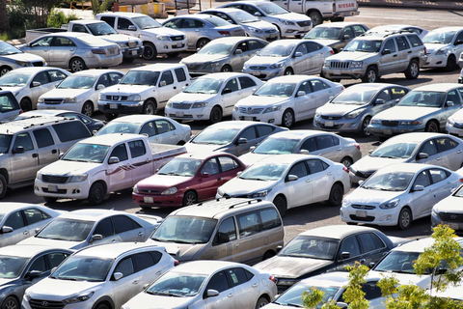
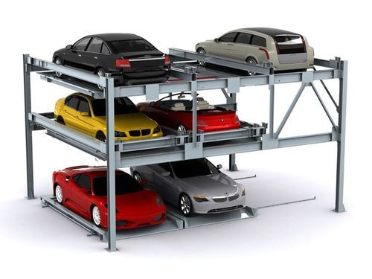
Overview: IoT Based Parking Occupancy Analyzer
Previously, we have made the Counter Project using Arduino & OLED Display. But this time we will send the data to our own created web server instead of simply observing it on OLED Display.

Slide 5


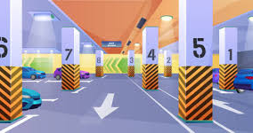
Problem Statement
In most of the worst-case driver fails in finding safe parking area, especially during the festive season and peak hours.
Decreased Management Costs Optimized Parking Reduced Traffic Reduced Pollution

Slide 6



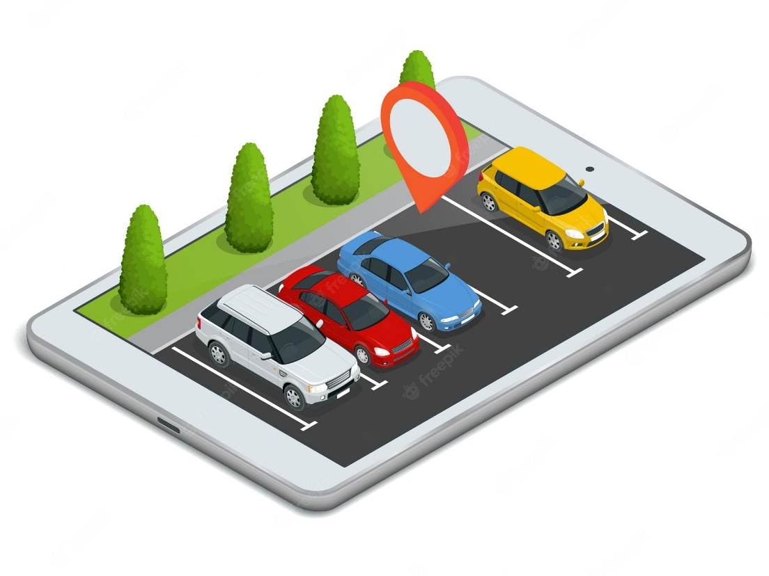
So what’s the Solution?
Innovative smart parking technology combined with IoT connectivity helps solve this problem. Installed IoT sensors determine where empty parking spaces are located. This IoT data is transmitted over a wireless connection to a cloud server. All the data from the parking lot is collected and analyzed in real-time to produce a map of available spaces made available to those looking for a space.

Slide 7
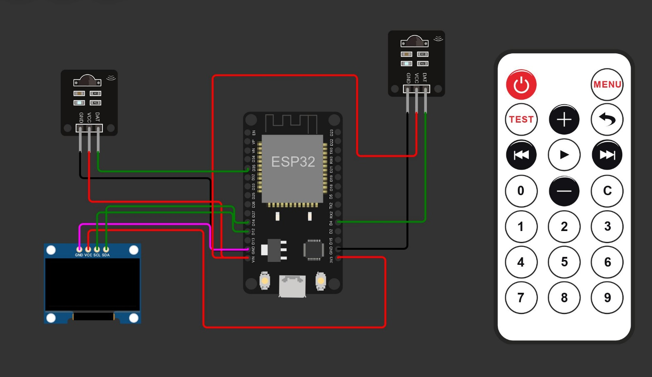
Components Used and Circuit Diagram
Breadboard
NodeMCU
IR sensors
Jumper wires
Power Source
OLED Display

Slide 8
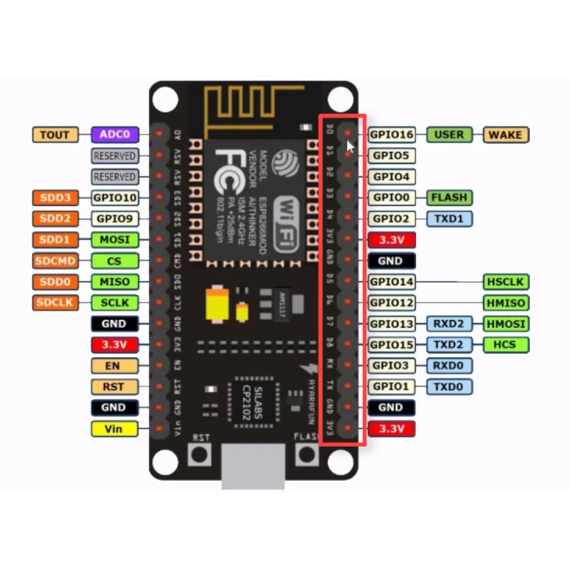
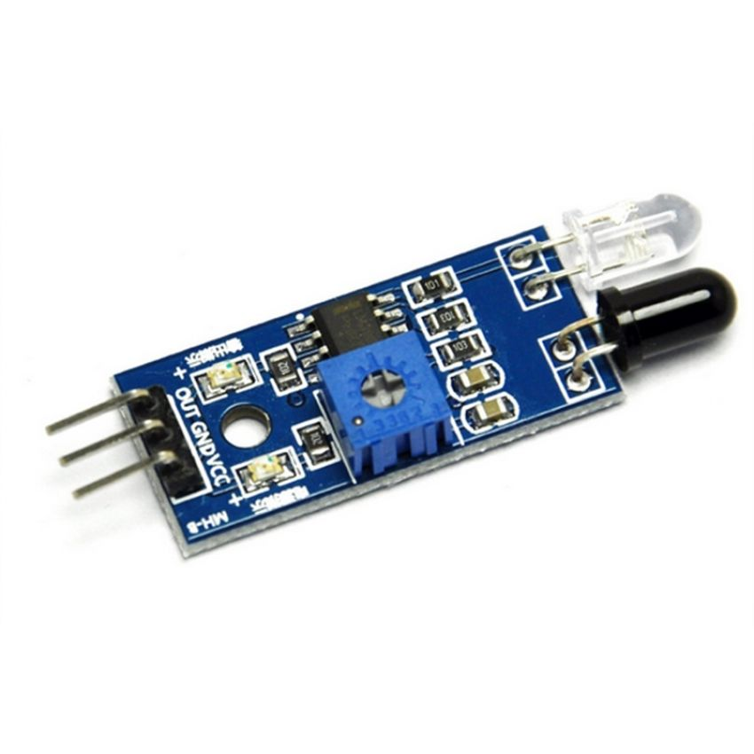
NodeMCU
As Arduino began developing new MCU boards based on non-AVR processors like the ARM/SAM MCU and used in the Arduino Due, they needed to modify the Arduino IDE so that it would be relatively easy to change the IDE to support alternate toolchains to allow Arduino C/C++ to be compiled for these new processors.
IR Sensors
IR sensor is an electronic device, that emits the light in order to sense some object of the surroundings.

Slide 9
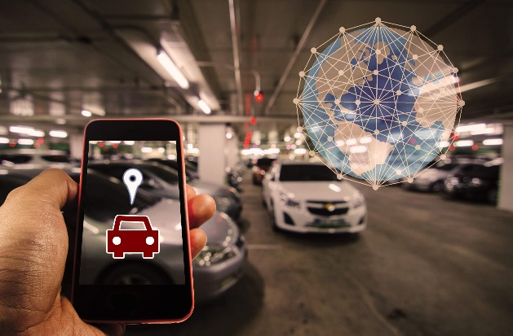
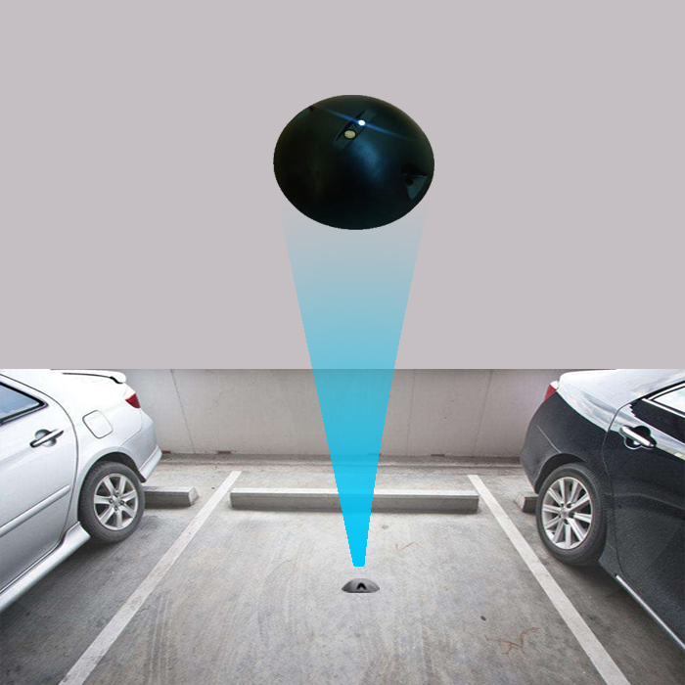
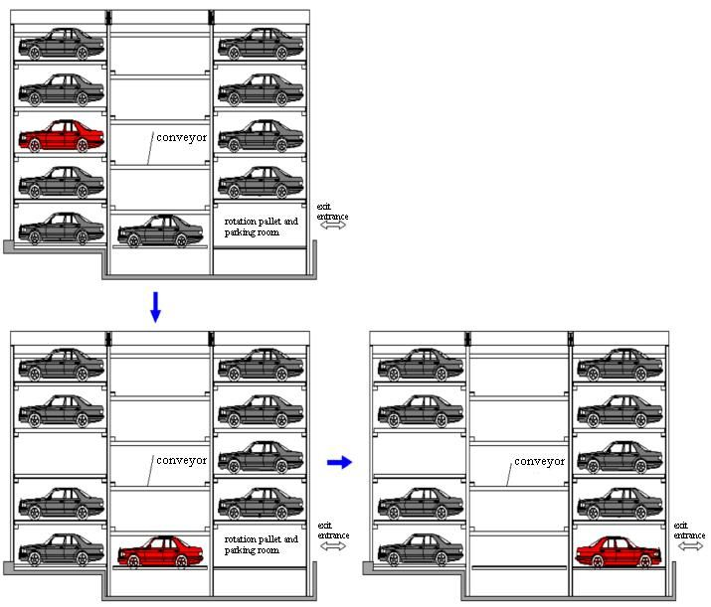
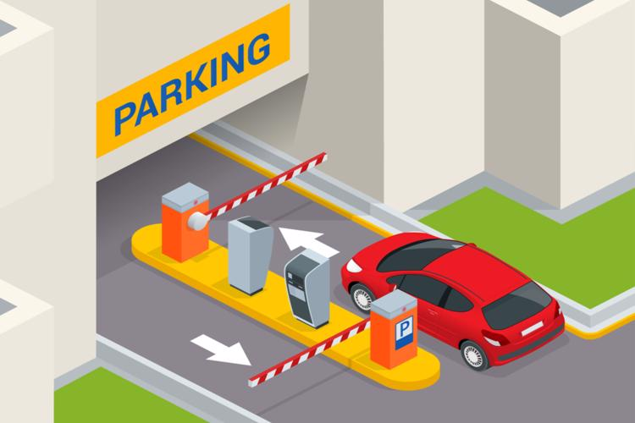
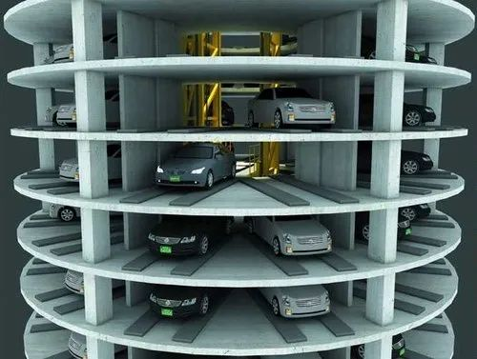
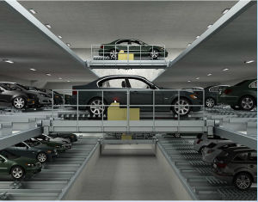
Working
Smart Parking System consists of Two IR Sensor and One OLED. Here, ESP8266 will control the entire process and send the parking status information to Cloud through Internet so that it can be checked from anywhere in the world through internet. Two IR sensors are used at the entry and the exit gate to check the presence of vehicle and process automatically close or open the gate.

Slide 10
Limitations of IR based Parking Space Occupancy Analyzer
Availability
Approximately 3 times more expensive than magnetometers or reflected intensity;
Higher current drain
Higher footprint 5x3mm which can be further increased for additional crosstalk compensation;
It is sensitive to any optical obstruction and obviously road may not be as clean and tidy as the lab settings;
A narrow emitted beam of light can be reflected in unpredictable ways as the bottom of the car is not flat.

Slide 11

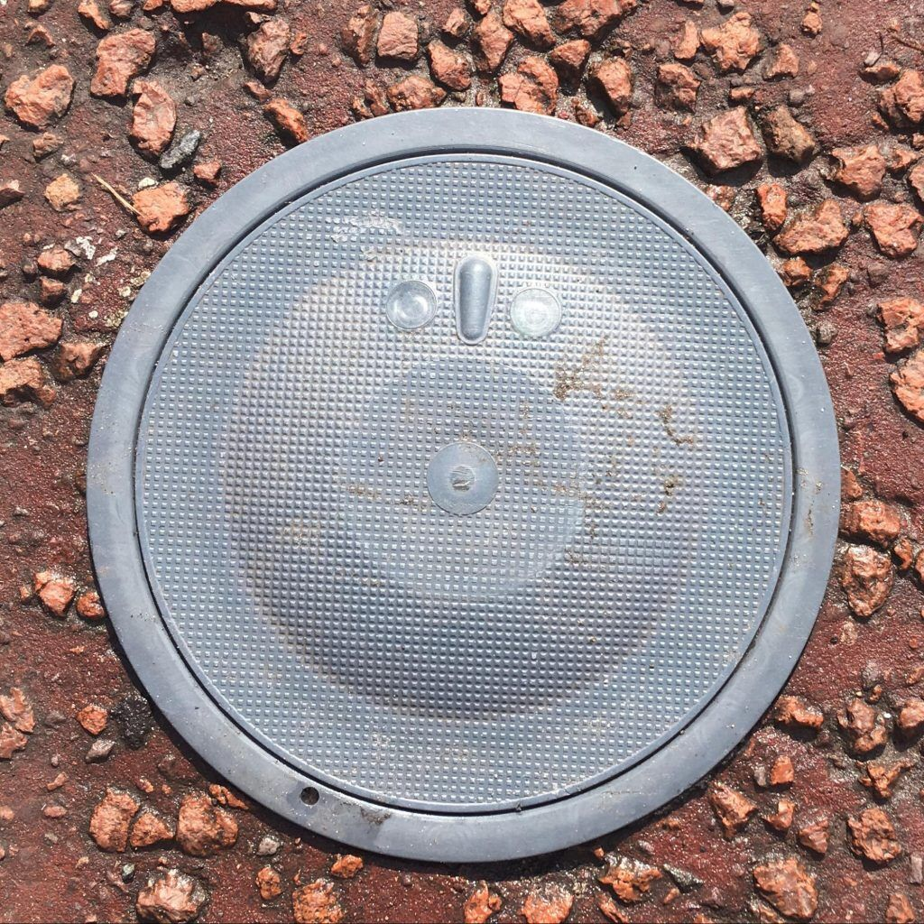
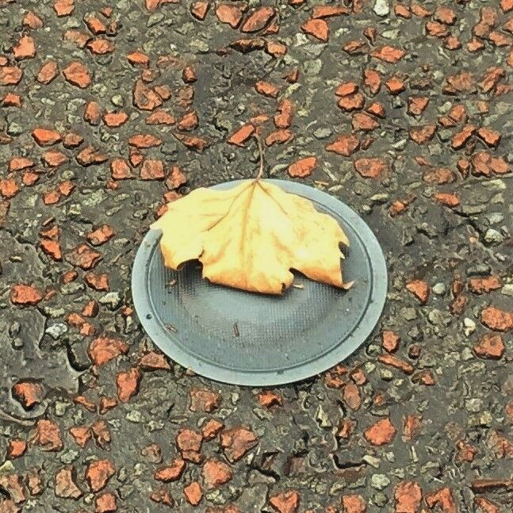
Real life example of its flaws

Slide 12
Future Aspects and Use cases
Here for the Future Aspects of the project,
Development And Deployment
Automated Parking
Parking Counter
AI, ML
Here for the advantages of the project,
Enhanced Parking
Reduced Congestion
Reduced Pollution
Enhanced User Experience
Driver's Experience
Improved Safety
Reduced Operational and Management Costs

Slide 13





References
Vinay Raj Tripathi, “Smart Vehicle Parking System Using IoT”, IEEE, 23 June 2020.
https://www.researchgate.net/publication/326351667_The_Development_of_Smart_Parking_System_based_on_NodeMCU_10_using_the_Internet_of_ThingsDenis Ashok, Akshat Tiwari, and Vipul Girje, “Smart Parking System using IoT Technology”, IEEE, 27 April 2020.
https://www.ijraset.com/research-paper/iot-based-smart-parking-system-using-node-mcu-esp8266
Wael Alsafery, Badraddin Alturki, Stephan ReiffMarganiec, and Kamal Jambi, “Smart Car Parking System Solution for the Internet of Things in Smart Cities”, IEEE, 23 August 2018.
https://www.ijert.org/iot-based-smart-parking-system-using-node-mcu-arduino-and-lcd-display
https://mytectutor.com/smart-car-parking-system-using-arduino-esp8266-nodemcu-and-blynk-server/
Notes:
Image source: Google - LRO Staffing, apa.org. measure evaluation, shutterstock

Slide 14
Thank You

